Slide 1

Disability 101

Slide 2



Our Sponsors:
J. Badger Consulting,
United Way of Southwestern Pennsylvania
Family Values at Work

Slide 3
Our Mission and Values
SAIL provides training and support for and by Pennsylvanians with disabilities to become strong agents for change.
Empowerment: Giving disabled people the confidence, skills, and support they need to take control of their own lives.
Support: Providing needed help and resources.
Advocacy: Encouraging people to help make change
Inclusion: Making sure disabled people can share their views
What we Offer
At SAIL, we offer a variety of opportunities tailored to meet the unique needs of individuals with disabilities.
Leadership Training: Comprehensive trainings that cover public speaking, policy analysis, and community organizing.
Advocacy Workshops: Hands-on sessions that teach the essentials of advocacy, from understanding legal rights to effective communication strategies.
A Peer Support Network: A chance to connect with others facing similar challenges, fostering a sense of community and shared purpose.

Slide 4
Disability in Pennsylvania
1,774,575 Pennsylvanians have disabilities (14.1% of the total population)
Pennsylvania’s employment rate is 79.7% for people without disabilities and 38.8% for people with disabilities
28.5% of working-age Pennsylvanians with disabilities live in poverty.
Philadelphia County has the commonwealth’s largest number of disabled people (261,440) and Forest County has the highest concentration of disabled people (28.4%)
Source: Annual Disability Statistics Compendium: 2020 Durham, NH: Univ. of New Hampshire, Institute on Disability
https://disabilitycompendium.org/

Slide 5
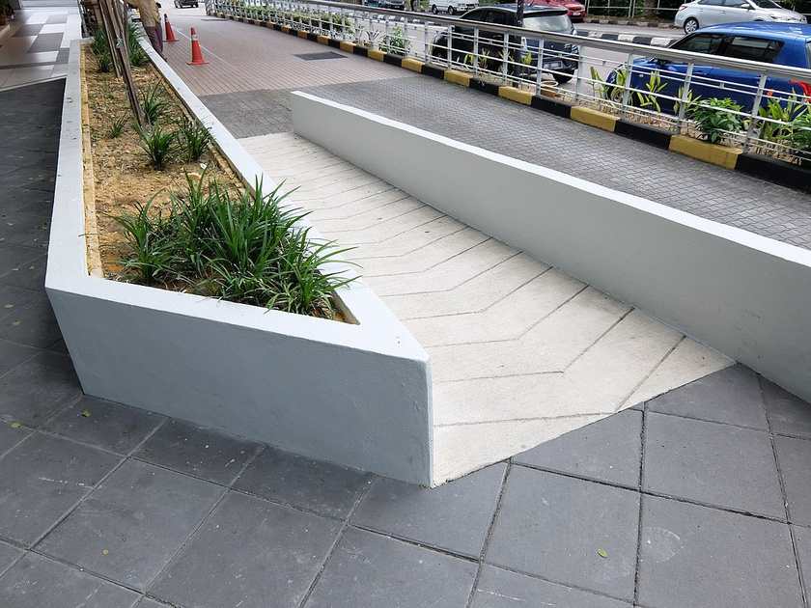
What mainstream society typically thinks accessible means
  Compliance with accessibility related laws and guidelines
  Ramps, parking spots, power button doors, and lower tables

Slide 6

Accessibility
Accessibility is not just about compliance, it’s also a frame of mind:
    Accessible meeting spaces, materials, and language
    Think outside the box: People’s experience of disability is unique to them
    Design with access in mind.

Slide 7
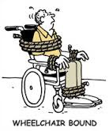
Dignifying Language
Don’t Use | Use
Handicapped, Special | Person with a Disability OR Disabled Person
Confined to a wheelchair, wheelchair buond | Wheelchair user
Suffering from | Living with or survivor of
Retarded | Intellectual disability

Slide 8
Disability Etiquette Video
Etiquette Video

Slide 9

US Disability Rights Law History
Workforce Innovation and Opportunity Act (WIOA)
Social Security Act
Education for All Handicapped Children's Act
Voting Rights Act
Affordable Care Act
Gave money to elders, , poor children, and people with disabilities
People with disabilities are able to have assistance in voting in elections.
requires public schools to provide appropriate educational services for all children with disabilities
Banned insurance from refusing to cover people with pre-existing conditions
Improves employment and education programs
1933
2014
1965
1975
2010
1900
1950
1975
2000
Today
1920
2014
1973
1990
1965
Smith-Fess Act
ABLE
Medicare & Medicaid
Rehabilitation Act
Americans with Disabilities Act
Established a federal program to provide vocational assistance to Americans with physical disabilities
first federal civil rights protection for people with disabilities that they can not be excluded or be subjected to discrimination under any program or activity receiving federal financial assistance
authorizes savings accounts for people with disabilities.
Provided federally subsidized health care to the disabled and elderly Americans
unrestricted access to public buildings, equal opportunity in employment, equal access to government services and employment opportunities

Slide 10
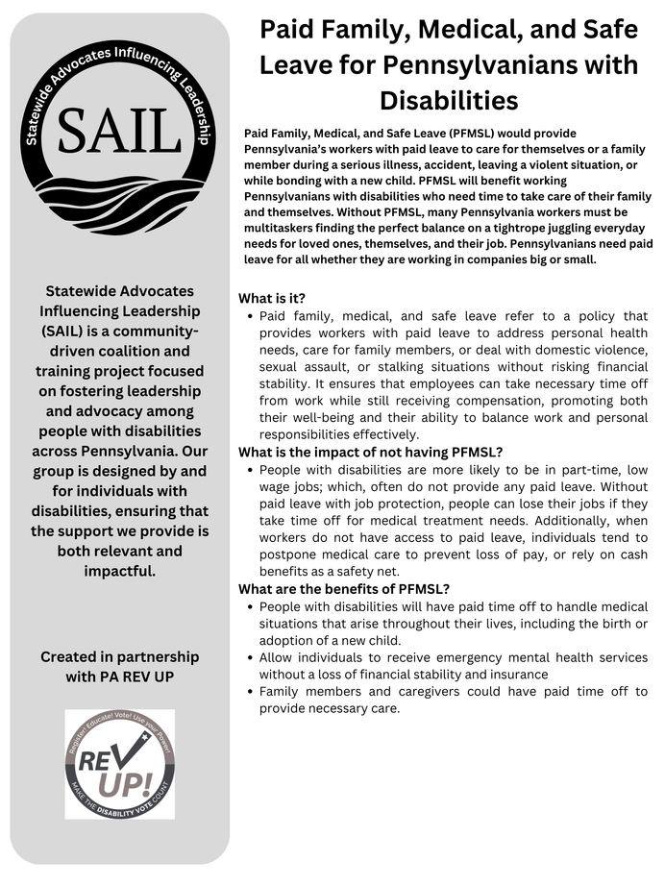
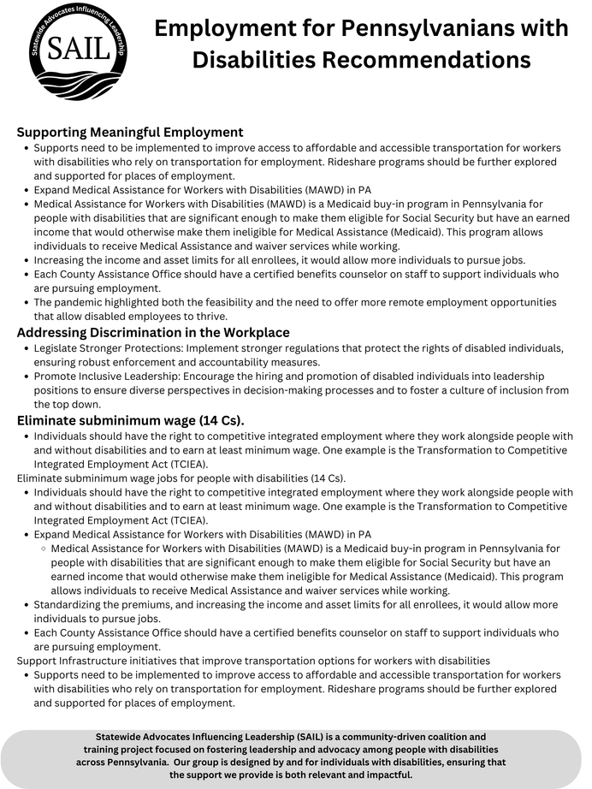
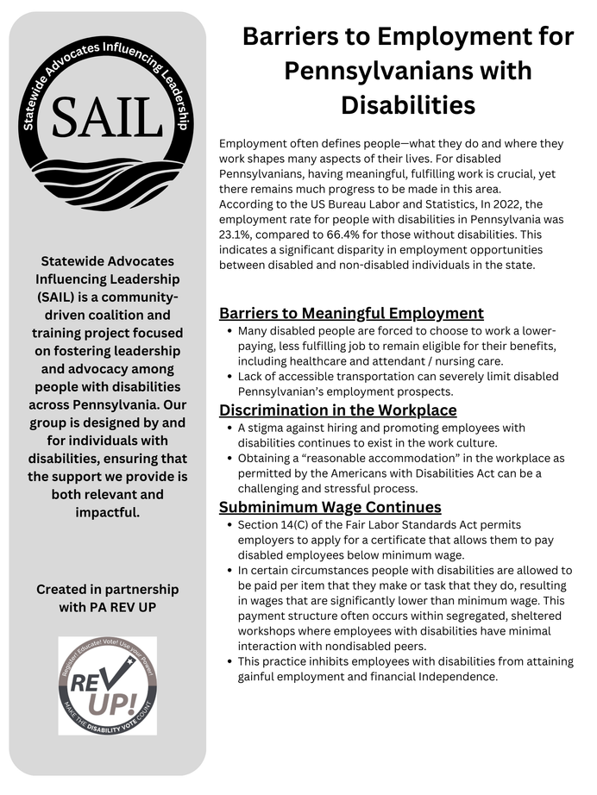
Policy Info Sheets
https://jbadgerconsulting.org/statewide-advocates-influencing-leadership-sail/

Slide 11
Next Lunch and Learn
Caregivers March 20th
Caregivers are a vital and necessary support, and this session highlights complexities for caregivers and those who are supported by them. Join us for important conversations with advocates on the complexities and barriers the disability community faces, and what we can do to move forward.
Healthcare May 15th
Our final session on healthcare highlights the importance of accessible, equitable healthcare, and the impact on our communities and individuals when access to quality healthcare is denied. Hear up to date information and stories that are vital to understand the urgency of having healthcare that is people first.
sail@jbadgerconsultinginc.org

Slide 12
TOP Takeaways
  Anyone can join the disability community
  Be aware of misconceptions on disability
  PWD are in your constituancy
  PWD want to be included, not an afterthought
(PWD - “People with Disabilities”)

Slide 13
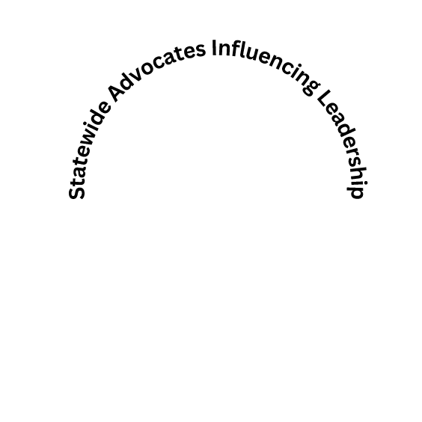
Thank You!
Contact sail@jbadgerconsultinginc.org for information and questions. We want
to support you.

Slide 14
Questions or Comments

